Slide 1
THE BALANCE POINT
By Julia D’Innocenzo

Slide 2
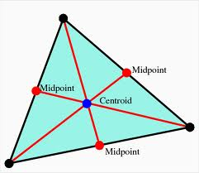
WHAT IS A CENTROID?
This project required us to find the centriod of a triangle and the centriod of a second shape that can have any number of sides. A centriod is known as the balance point of an object. In a triangle the centriod is the point of concurrency of the medians. The centroid always stays IN the triangle. This point is where all the medians of a triangle intersect. The centroid is located two thirds of the distance from each vertex to the opposite side’s midpoint. The centroid is one third of the distance from the vertex to the opposite side’s midpoint(2:1 ratio).
2/3
1/3

Slide 3
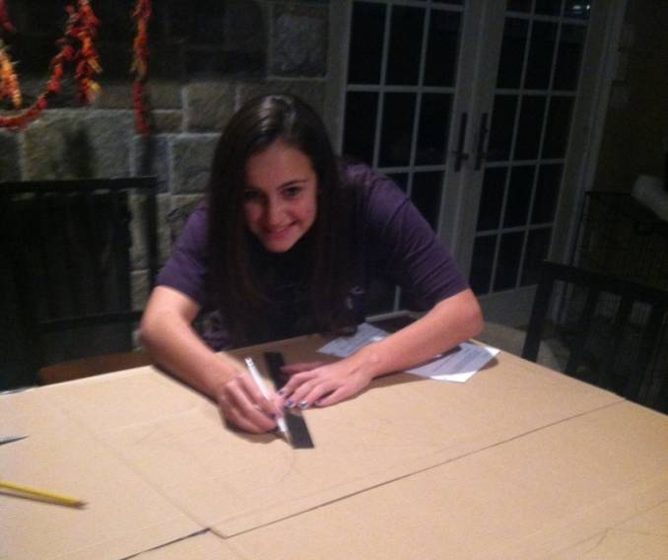
METHOD 1: MEASURE WITH A RULER
One method I used to locate the centroid in my triangle was to measure with a ruler. I really liked this method because it was easy to use and it gives you an exact point. You couldn’t really mess up while using this skill. The only thing someone could do wrong with using this skill is sometimes when you apply the centroid theorem the numbers don’t come out perfect but the balance point still works. This could be contributed to human error.

Slide 4
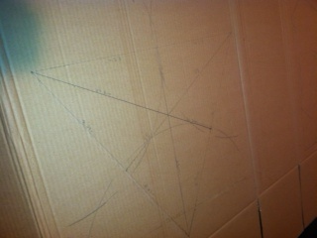
METHOD 2: USE A COMPASS AND DO A CONSTRUCTION
The second method I used to find the centroid in my triangle was to make a construction with a compass. I liked this method because we practiced it a lot in class so I found it easy to do. Also it is very accurate. The only problem with this method is your compass might be a little too small for the triangle. Therefore you have to use a really long pencil or make you own compass. I used a really long pencil for my constructions.

Slide 5
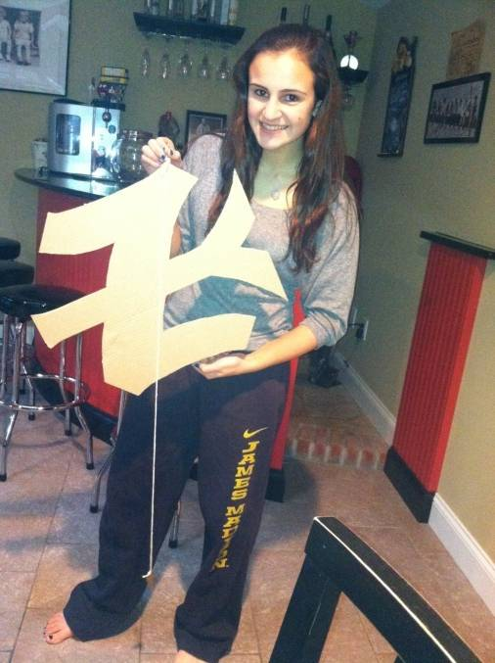
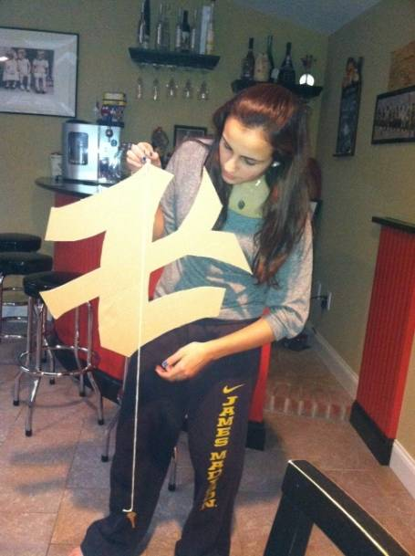
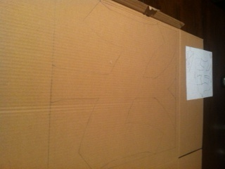
METHOD 3: PLUMB BOB
In order to locate the centroid of the Yankee sign I needed to use the Plumb Bob method. This method frustrated me because each time I did it, the string wouldn’t stop moving and when I tried to balance the shape it didn’t work. It took me three tries and I finally got it. If done correctly, the plumb bob method is very useful but you can’t do it by yourself. You need to have someone help you. You could do it by yourself but it is very difficult. You might get the wrong point.

Slide 6
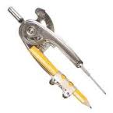
I THINK THE BEST METHOD IS…..
Every method you use on the triangle will find you the same centroid. But some methods are easier than others. I thought that the easiest method was using the ruler to measure. It was the easiest because it was very accurate. Also you can’t really mess up. I feel that the plumb bob isn’t the best thing to use because its hard to get the point accurate. Your hand has to be very steady and be very patient.

Slide 7
CENTROID THEOREM:
2:1 ratio from the vertex to the opposite sides midpoint
Median #1
24.8cm : 12.3cm
Median #2
25cm : 12.5cm
Median #3
25cm : 12.5cm
This theorem doesn’t come out perfect every time but the data is accurate. My second and third median came out perfect but my first median was off by .1cm.
24.8cm
12.5cm
12.5cm
25cm
12.3cm
25cm

Slide 8
IN CONCLUSION……….
In conclusion, I think the best methods for locating the centroid of a triangle are the compass and the ruler method. They seem the most accurate and efficient. This was a fun project because I liked how we could combine mathematics with creativity. Also how we were able to come up with our own shape and we got to decide what methods we could use to find the centroid.

